Slide 1
Coursera capstone Opening a new sushi bar in Saint Petersburg, Russia
By: Pavel Kravetskiy
June 2019

Slide 2


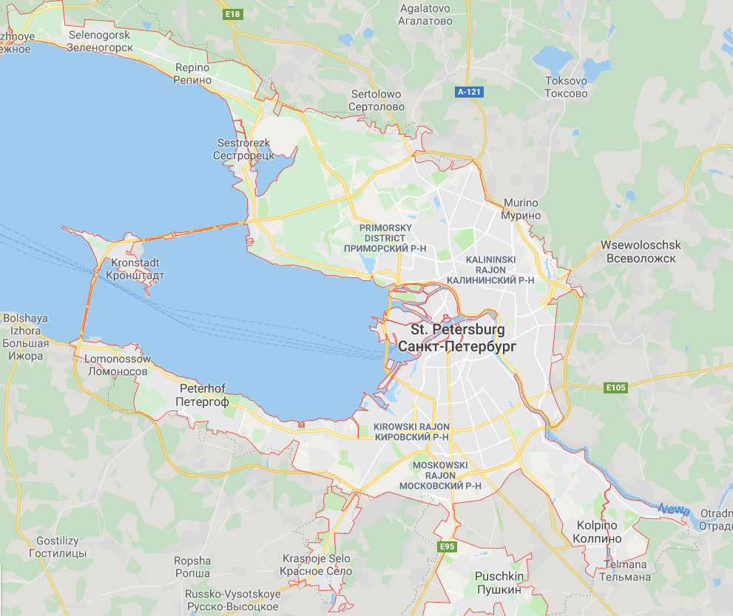
Introduction
Saint Petersburg overview
Description
Location
Business perspective

Slide 3
Business problem
Business question: Which neighborhoods would be a good choice for opening a new sushi bar in Saint Petersburg, Russia?
Analysis and selection of the best location for a sushi bar
Using exploratory data analysis
Using clustering algorithm
Success criteria

Slide 4
Data
Data required:
List of neighbourhoods in Saint Petersburg
Latitude and longitude coordinates of those neighbourhoods
Venue data, particularly data related to sushi bars

Slide 5
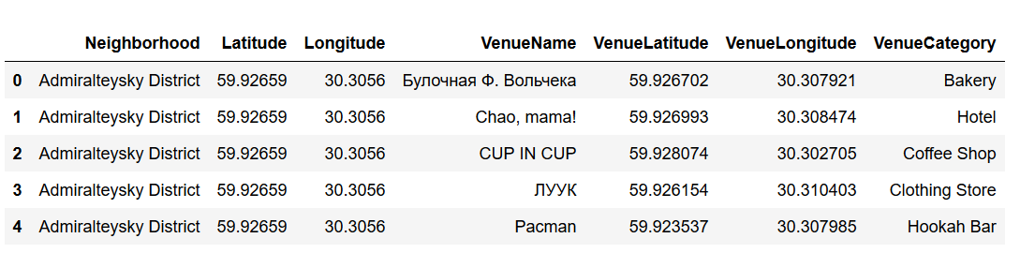
Data

Slide 6
Methodology
Web scraping Wikipedia page for neighbourhoods list
Cleaning of the data
Get latitude and longitude coordinates using Geocoder
Use Foursquare API to get venue data
Group data by neighbourhood and taking the mean of the frequency of occurrence of each venue category
Filter venue category by sushi bar
Perform clustering on the data by using k-means clustering
Visualize the clusters in a map using Folium

Slide 7
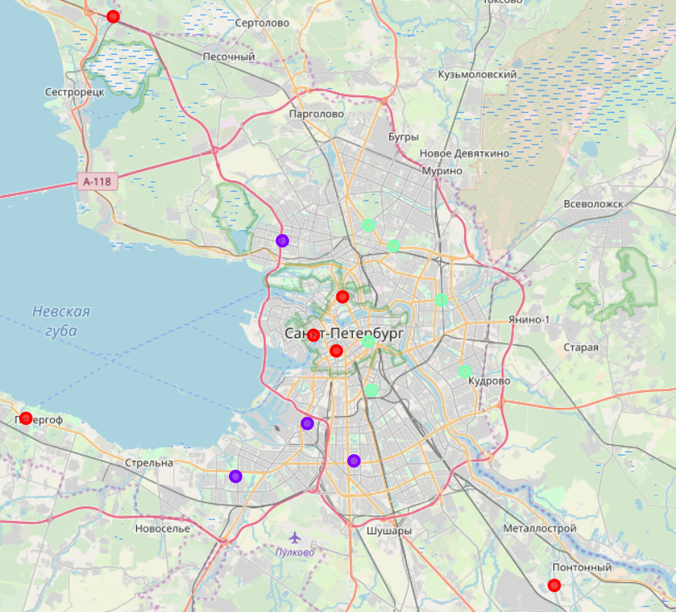
Results
Categorized the neighbourhoods into 3 clusters :
Cluster 0: Neighbourhoods with low number to no existence of sushi bars
Cluster 1: Neighbourhoods with moderate number of sushi bars
Cluster 2: Neighbourhoods with high concentration of sushi bars

Slide 8
Discussion
Most of the sushi bars are concentrated around the central area of the city
Highest number in cluster 2 and moderate number in cluster 1
Cluster 0 has very low number to no sushi bars
Findings of this project will help the relevant stakeholders to capitalize on the opportunities on high potential locations while avoiding overcrowded areas in their decisions to open a new sushi bar in Saint Petersburg

Slide 9
Conclusion
Open a new sushi bar in neighbourhoods in cluster 0 with little to no competition
Can also open in neighbourhoods in cluster 1 with moderate competition if have unique selling propositions to stand out from the competition
Avoid neighbourhoods in cluster 2, already high concentration of sushi bars and intense competition

Slide 10
Thank you for your attention!

